Slide 1
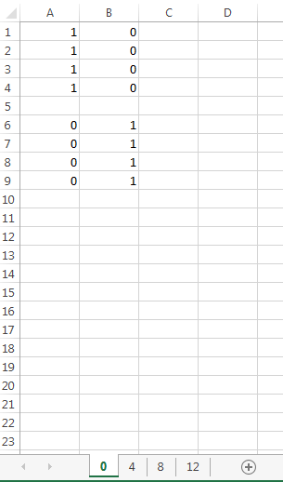
Each column represents one phenotypic state. In this example there are only two identified phenotypic states
Each row represents one replicate. The entries are the fractions of each phenotypic state at that time-point (sheet name)
Empty rows (optional) serve to separate replicate groups, that correspond to purification or enrichment of a particular phenotype. The enrichment (if any) is assumed to happen at time-point 0
Mandatory: Each sheet name has to be an integer representing the experimental time-point (units are arbitrary (hours/minutes/days)
When using Population fraction data, only a single file is to be uploaded

